Slide 1
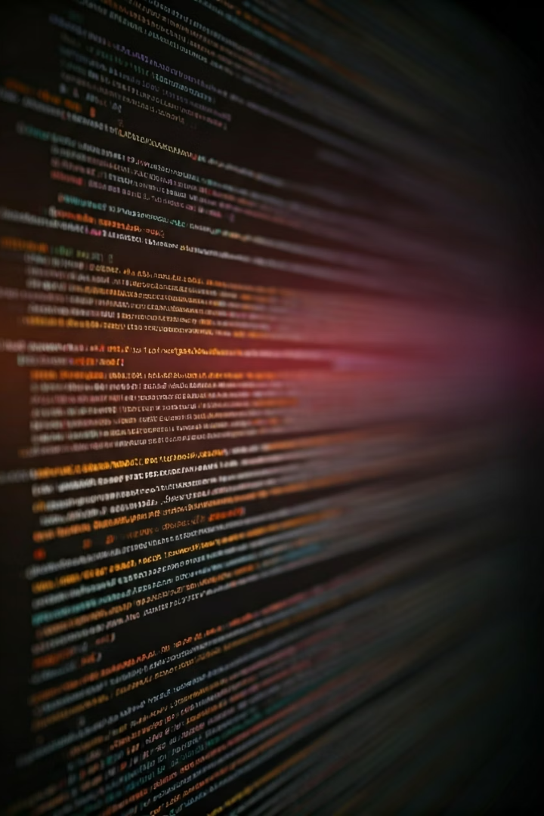
Git Essentials: A Quickstart Guide

Slide 2




What is Git?
Distributed Version Control
Open-Source & Free
Tracks & Manages Changes
Created by Linus Torvalds in 2005, Git is a widely adopted, free, and open-source system.
Git allows every developer to have a full copy of the project history, enabling offline work and robust collaboration.
It efficiently tracks file changes, manages different versions, and facilitates seamless collaboration among teams.

Slide 3
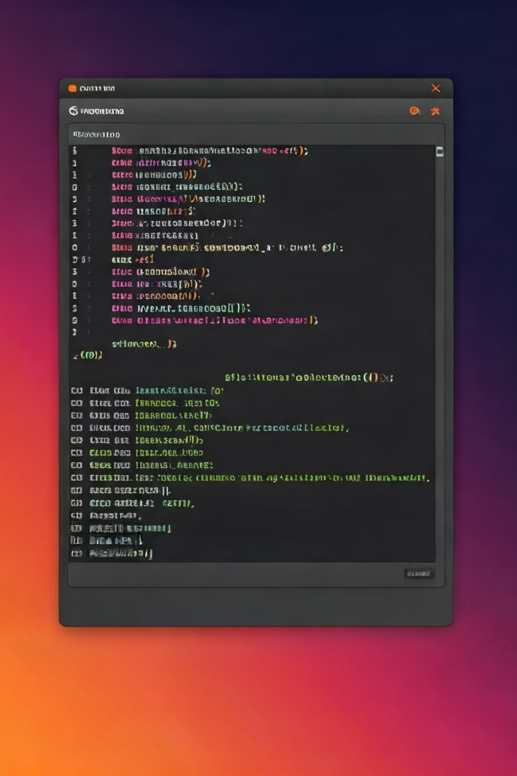



Repository Initialization
git init
Creates a new local Git repository.
Initializes a hidden .git folder.
git config
Sets your user email for commits.
Ensures proper attribution.
git remote add
Connects your local repo to a remote URL.
Links to platforms like GitHub.

Slide 4
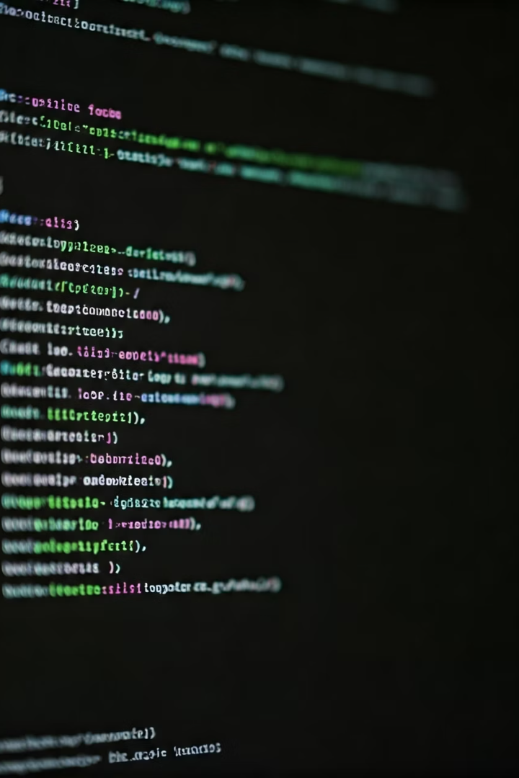




git init
git init
Initializes a new Git repository. Creates a .git directory in your project folder.
git config --global user.email "you@example.com"
Sets the email address to be used for your commits.
git config --global user.name "name"
Sets the author name to be used for your commits.
git config --global user.email
Displays your configured email address.

Slide 5
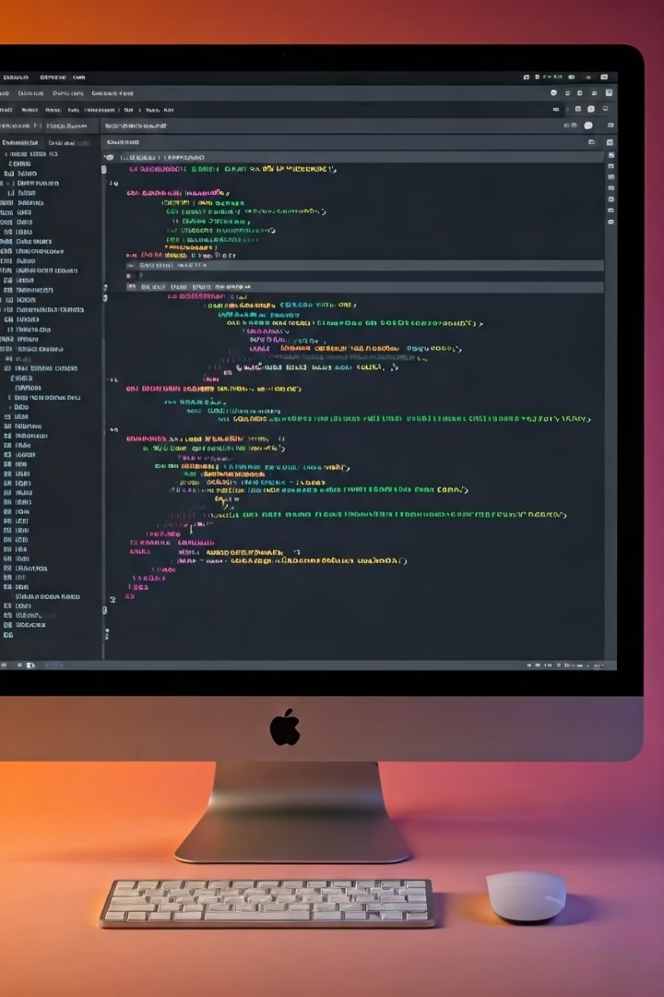
File Management
git add .
git status
Stages all new or modified files.
Displays the current status of files.
Prepares them for the next commit.
Shows untracked, modified, or staged files.
git ls-files
Lists all files currently tracked by Git.
Confirms what Git monitors.

Slide 6
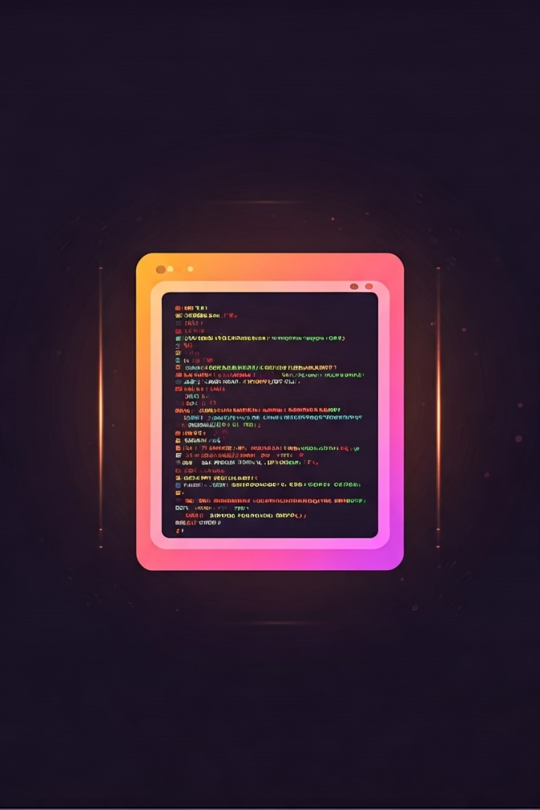





Essential Git Commands
Add Files
Check Status
List Files
git add .
git status
git ls-files
Create File
Remove File
echo "Your file content here" > filename.txt
git rm -r <file_name>

Slide 7

Cloning and Fetching
git clone <link>
git pull
Downloads a full repository.
Fetches changes from the remote.
Includes entire project history.
Merges them into your current branch.
Keeps your local copy updated.

Slide 8

git clone
git pull origin <branch_name>

Slide 9
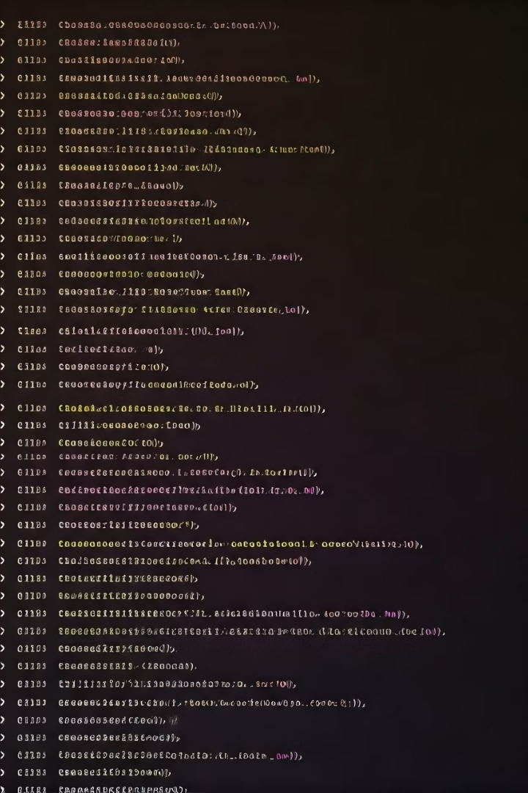



Commit History
git log
Displays a chronological list of commits.
Shows author, date, and commit message.
Detailed Information
View commit hashes for reference.
Understand project evolution.
Concise View
Use --oneline for brief summaries.

Slide 10
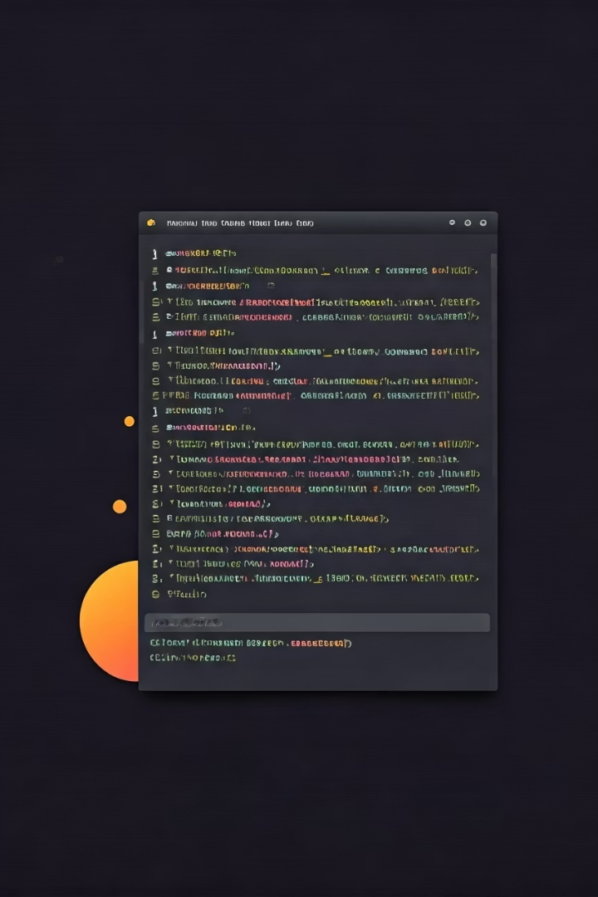
Examining Differences
1
2
3
Identify Changes
Compare Versions
Track Evolution
See what has been added or removed.
Understand code evolution effectively.
Compare any two commits or branches.
The git diff command reveals changes. It highlights differences between files or commits. This helps in code review and debugging.

Slide 11



Essential Git Commands
git commit -m "any message"
git log
git diff [source] [target]
Saves staged changes to the repository, creating a new snapshot of your project with a descriptive message.
Displays a chronological list of all commits in the current branch, showing author, date, and commit message.
Shows the differences between two commits, branches, or the working tree and the index, highlighting changes line by line.

Slide 12



Branching
Branches enable parallel development workflows. They allow features to be built independently.
git branch <name>
2
Creates a new branch.
Ideal for new features.
git branch
1
Lists all local branches.
Shows current active branch.
Isolate Development
3
Work on features without affecting main code.

Slide 13




git branch
Create and Switch
git branch -b //create and switch
Switch to Existing Branch
git checkout main //switch to existing branch
Rename Current Branch
git branch -m //rename current git branch

Slide 14
Pushing Changes
git push
Sends your local committed changes to a remote repository (e.g., GitHub). This is essential for sharing work and collaborating.
Share Work: Publishes local commits to the remote.
Update Branches: Keeps the remote repository current.
Collaborate: Allows team members to integrate your contributions.
Usage: Typically `git push origin main`.

Slide 15



Conclusion
Git is an essential tool for modern development. It empowers teams to collaborate seamlessly. Mastering Git boosts productivity and code quality.

